Slide 1
Easy eComm US market entry made simple!

Slide 2
Notes:
https://youtu.be/59FYLW8wxwM

Slide 3
Meet your team!
Rachael van Harmelen
Director, Business Development- Fashion & Retail
Your Project Lead for Easy eComm in the US (phases I & II)
rachael.vanharmelen@hellmann.com
Richard MacLaren
Senior Director, Business Development Contract Logistics
Your Easy eComm expert in the US (phase III)
richard.maclaren@hellmann.com
Frank Asta
Vice President, Customs Brokerage
Your Customs Brokerage expert in the US
frank.asta@hellmann.com

Slide 4
Introducing our Easy eComm End-to-End Model
Easy eComm Phase I:
International Fulfilment from Origin
Type 86 Entry
Final Mile Injection
Return Logistics
Easy eComm Phase II:
International Returns Consolidation Center
Outlook: Easy eComm Phase III

Slide 5
1. Introducing our Easy eComm End to End Model

Slide 6
Your Journey with Hellmann Executing an e-fulfillment market entry strategy with a phased approach
I
II
III
2-3 weeks
International fulfillment from origin including customs, final mile, returns and consolidated returns to origin
2-3 months
International returns center based in the USA with option of picking from returns
6-9 months
In-market fulfillment located in the optimal location

Slide 7
2. Easy eComm: Phase I

Slide 8
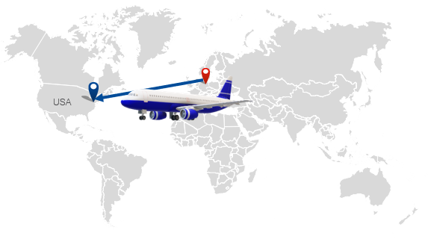
Phased Approach International fulfilment from origin
Example: dress HAM - JFK
Customs entry process following type 86 informal entry
Education for documentation set-up (commercial invoice, entry format, etc.) and registration as Importer of Record
Injection into final delivery utilizing a customized solution based on customer concentration
Overall implementation timeline is just 2-3 weeks

Slide 9
Type 86 Customs Entry Saves time and money for customers looking to enter the US Market
Global e-commerce has drastically increased the number of international shipments
Entry Type 86, is a new customs entry type for imports with a de minimis value of < $800 intended to help Customs and Border Protection (CBP) manage the flow of goods, creating greater visibility while improving border protection, import security, and safety
When imported under this designation, importers (shippers, purchasers, or designated customs brokers) are not required to file for formal entry (saving time) of their goods into the US, or to pay taxes and duties (saving money)

Slide 10
Type 86 Customs Entry How it works
Hellmann Customs Brokerage team transmits information via an automated interface with Customs
Customer uploads US Customs manifest to Hellmann provided SFTP prior to uplift from origin
Hellmann has customized piece-level manifest specification file
Customer or Freight Forwarder sends full pre-alert to Hellmann Brokerage team incl. MAWB copy and flight schedule
Hellmann can offer freight forwarding services
Hellmann validates manifest data, converts to entry and uploads to US Customs
API available or Hellmann can integrate into customer software
US Customs reviews data and releases or flags parcels for exam within 24 hours of arrival
Validation tool checks for missing or invalid information
Hellmann software can be installed at customer site which validates data pre-upload and can be utilized for gateway sorting
Tracking events available for “Customs Held” or “Customs Release” status
Events can be customized to meet customer format
Hellmann recovers from carrier and brings back to CFS Bonded Facility
Recovery in 1-4 hours (varies based on flight)
Exam holds are held at Hellmann CFS, remainder of consolidation is released
Hellmann stores freight at its CFS facility until parcels are released, typically the day of arrival
Hellmann offers final mile delivery
Final mile carrier can collect from Hellmann

Slide 11
Final Mile Injection Getting the order to your end customer
Option A: Tap into Hellmann’s carrier network
Benefit from our contracted rates
Seamless process
US countrywide coverage (via LAX, JFK, and ORD Gateways)
Transit times: Ground 2-6 days & Ground/Air 2-5 days
Tracking information: we will facilitate interface integration
Option B: You already have a contract with a parcel service provider? No problem, Hellmann can coordinate using your contract.

Slide 12
Return Logistics
Return Process
Customer places label on package
Option 1) Customer brings it to a drop off location, specified by courier
Option 2) Customer arranges a pickup of the package
Refund
This will be triggered when courier receives the package.
Customer return label
Return label needs to be printed from courier. Instructions are included with purchase on the invoice
Receipt at our returns center
Option 1) QC inspection, rate from 1-5. Store return until agreed amount to return to origin
Option 2) Pick from returns
Option 2) Product destruction

Slide 13
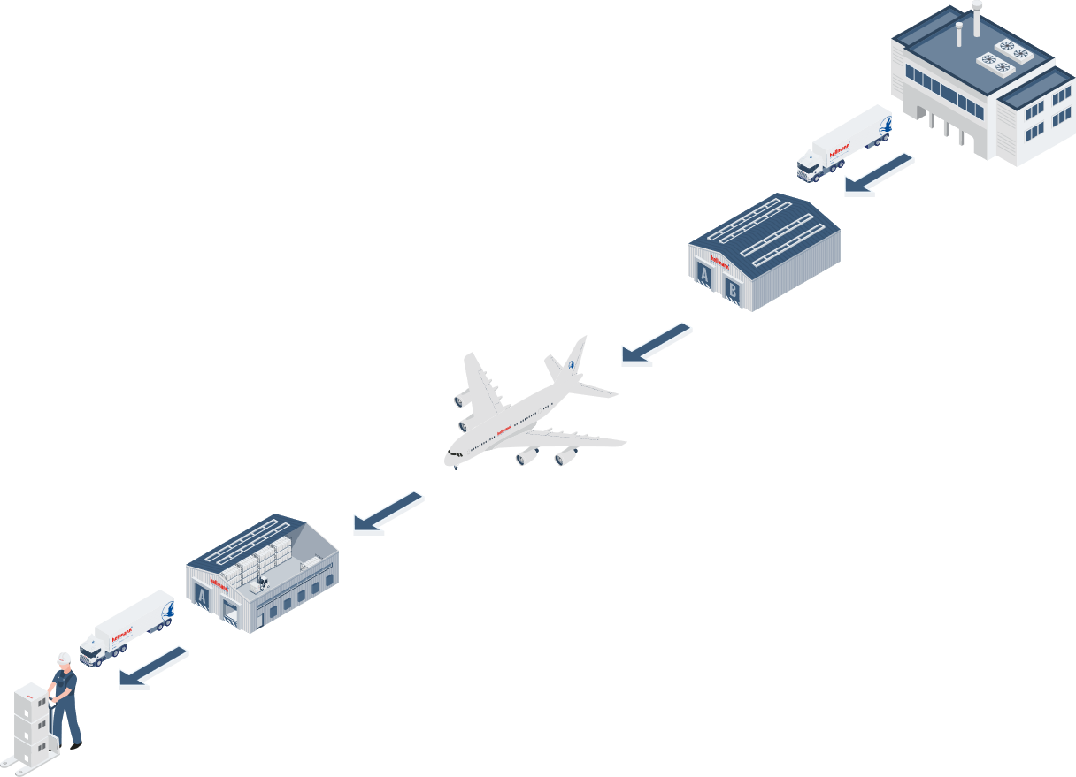
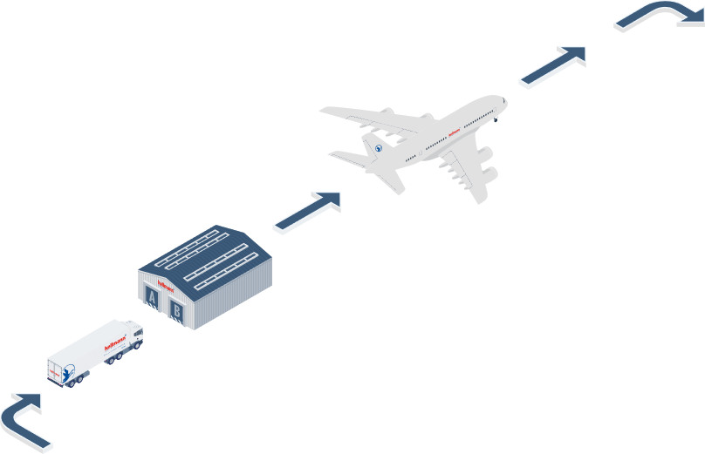
End-to-End Model
1
Pickup
Nonconsolidated flight from JFK to origin
7
2
Arrival at Hellmann
Air Export Warehouse
Return from customer to facility
6
3
Consolidated flight to JFK
4
Pickup arranged from JFK to facility.
Packages cleared via 86 entry.
5
Final mile delivery to your customer

Slide 14
3. Easy eComm: Phase II

Slide 15
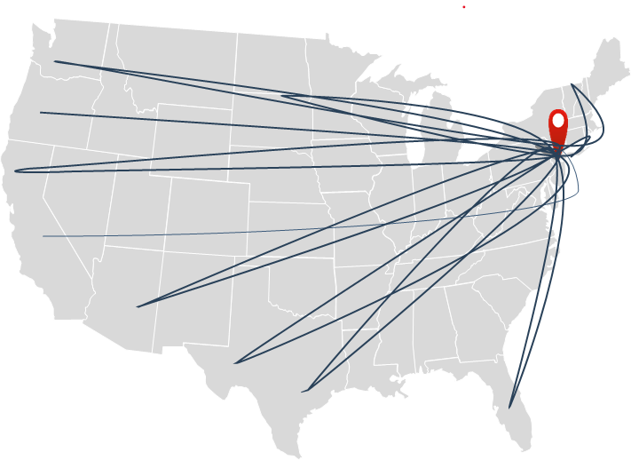
Easy eComm: Phase II International Returns Consolidation Center
Providing our customers with a simple local return solution
End customer returns received and visually inspected
Hellmann will collect and consolidate all US returned items, then ship them back to origin in bulk, at the agreed frequency
Throughout this process you will have complete visibility of inventory and know exactly what returns Hellmann is holding
Not only does this process drastically reduce the physical cost of the returns, giving end customers complete assurance that they can return purchases locally (vs. having to ship internationally), making them feel more confident about ordering in the future
Building end consumer confidence and the ability to offer a convenient return policy are fundamental to selling online and critical to success

Slide 16
4. Outlook - Easy eComm: Phase II

Slide 17
Outlook - Easy eComm: Phase III Establishing your own US Distribution Center
The benefits of in-market fulfillment
Get fast cost-effective fulfillment while showing off your brand (doesn’t arrive in an Amazon box)
Own your own customer, sales, and inventory data to make informed decisions about business growth
Manage the moments that build brand loyalty and keep your business top of mind, sales to delivery
Get packages to customers quickly, leverage Hellmann shipping options, final mile delivery with multiple options
2-day delivery is standard in the US
Be able to provide flexibility and respond to customer needs Full-service eCommerce facility with scalability

Slide 18
Thank you for your attention!
www.hellmann.com

